Slide 1

Flora & Fauna
Academic Services Group
Notes:
Kaleigh
Team name - Academic Services Group
Introduce ourselves
Overview of project
Project objectives

Slide 2
Project Objectives
Design a mobile application on Android
Create search methods and filters that coordinate with APIs
Allow storing/grouping recordings
Develop an interactive map
Notes:
Kaleigh

Slide 3
Demo
Notes:
Nathan
Functional Requirements (project objectives elaborated on here)
Basic Search
Filter
Species Page
Personal Recordings
Downloading
Settings
Map
Basic Features
Image Recognition
Nonfunctional Requirements
Intuitive interface
Screen sizes
Loading times (3G minimum)

Slide 4
Functional Requirements
Basic Features
Basic Search
Species Page
Settings
Filter
Map
Downloading
Image Recognition
Personal Recordings
Notes:
Nathan
Functional Requirements (project objectives elaborated on here)
Basic Search
Filter
Species Page
Personal Recordings
Downloading
Settings
Map
Basic Features
Image Recognition

Slide 5
Nonfunctional Requirements
Intuitive interface
Screen sizes
Loading times (3G minimum)
Notes:
Nathan
Nonfunctional Requirements
Intuitive interface
Screen sizes
Loading times (3G minimum)

Slide 6
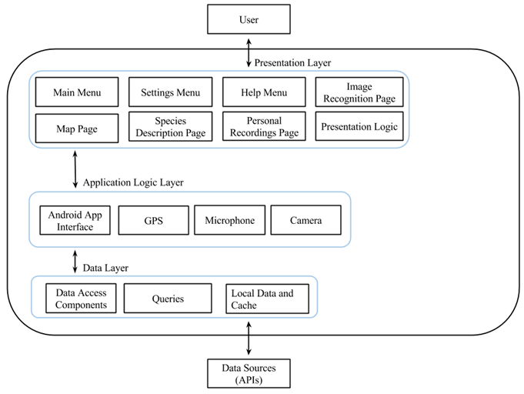
System Architecture
Notes:
Kaleigh

Slide 7
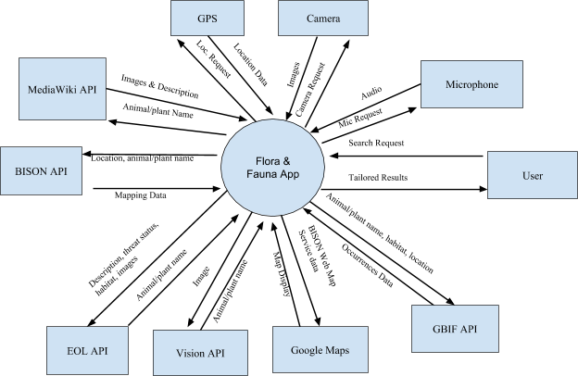
Context Diagram
Notes:
Shelby

Slide 8
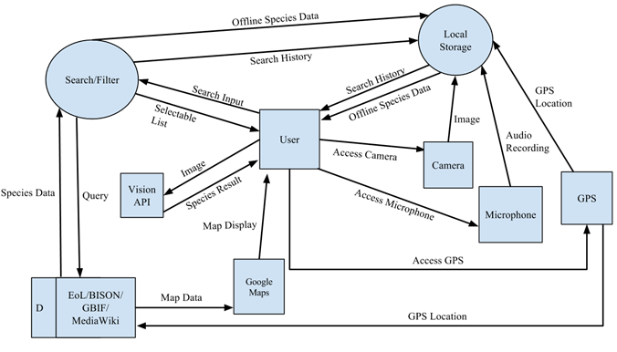
Data Flow Diagram
Notes:
Chris

Slide 9
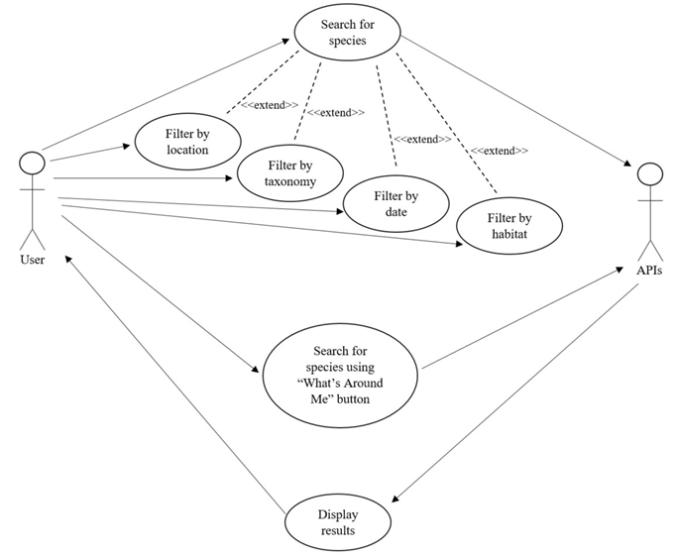
Use Case Diagrams
Notes:
Brad

Slide 10
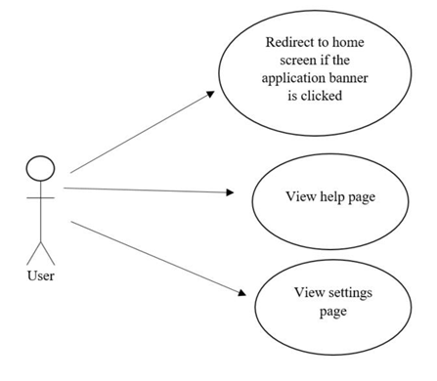
Use Case Diagrams
Notes:
Brad

Slide 11
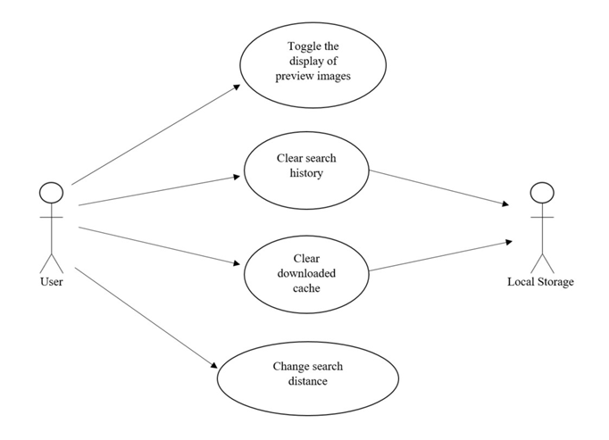
Use Case Diagrams
Notes:
Brad

Slide 12
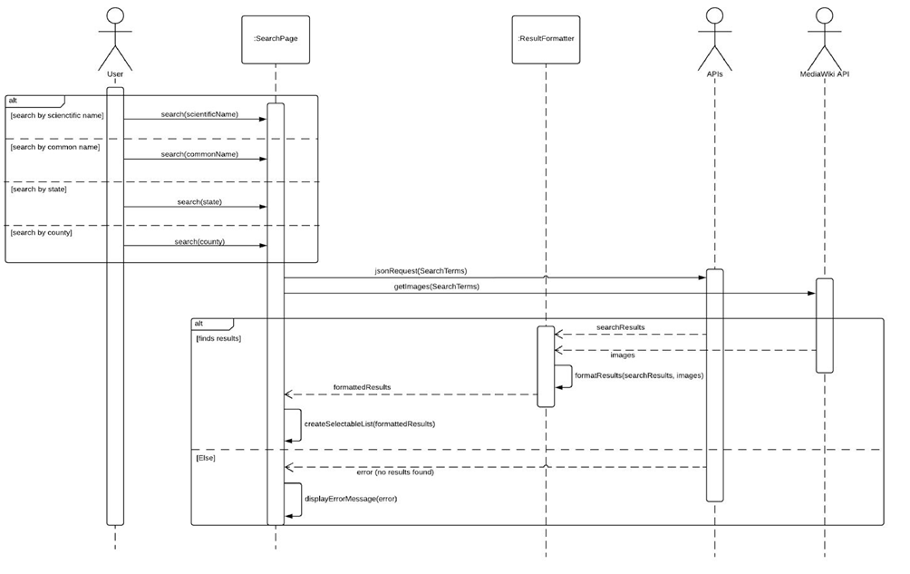
Sequence Diagrams
Notes:
Kaleigh

Slide 13
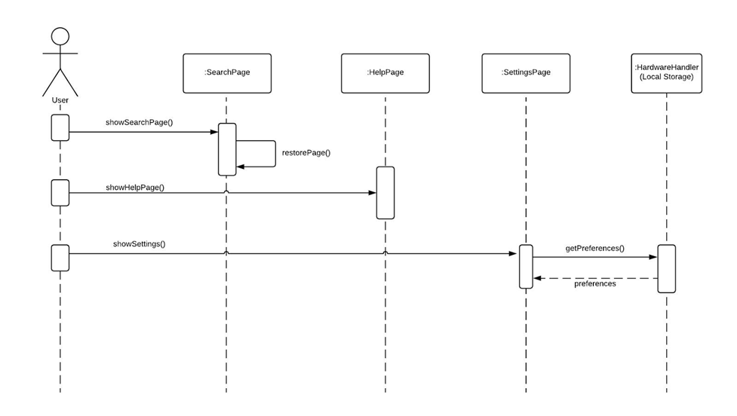
Sequence Diagrams
Notes:
Kaleigh

Slide 14
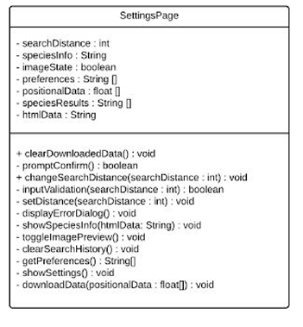
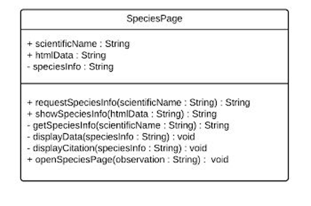
Class Diagrams
Notes:
Michael

Slide 15
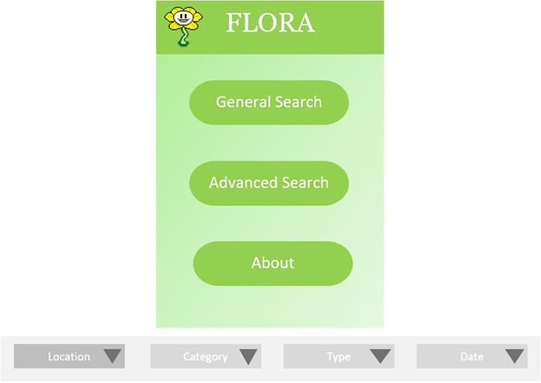
Initial Prototype
Notes:
Brad

Slide 16
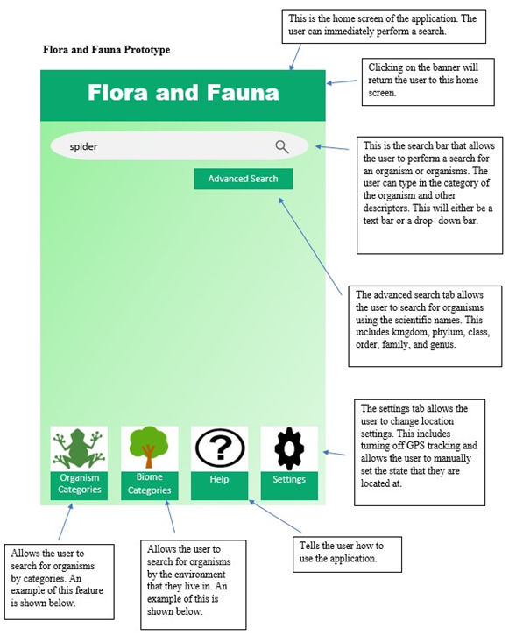
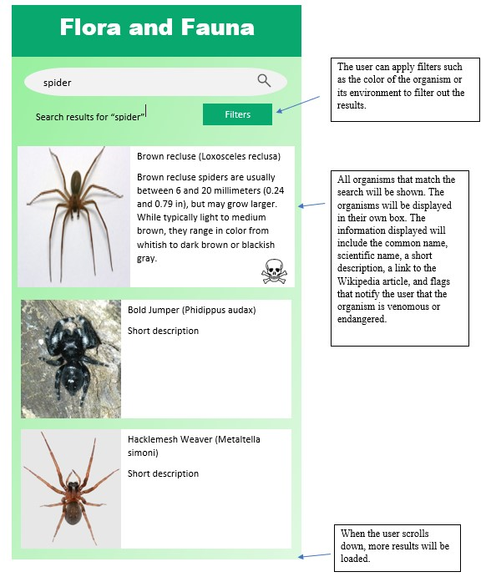
Second Prototype
Notes:
Brad

Slide 17
Client Feedback
Notes:
Shelby
Working with clients to figure out requirements
Dr. Box
Todd Buffington
Emma Boehm

Slide 18
System Evolution
Notes:
Brad

Slide 19
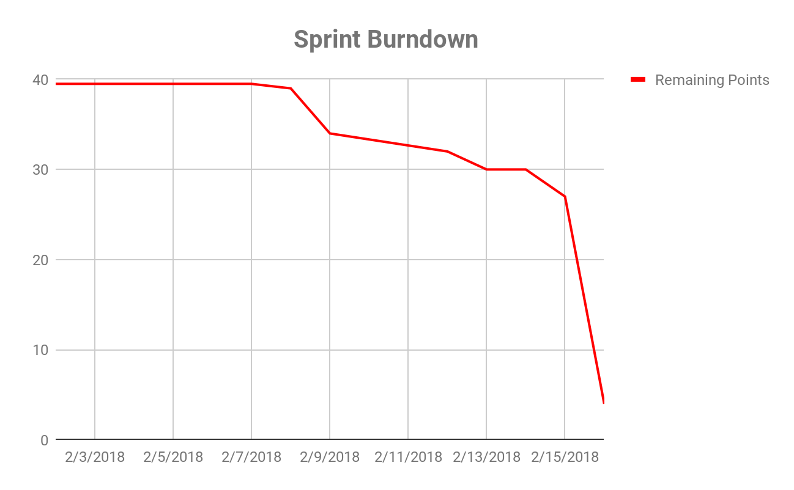
Sprint
Planning
Story points
Issues
Improvements
Lessons
Notes:
How did we plan our sprint? Planning Poker? - Shelby
Did we accomplish all the story points for our sprint? - Chris
Did we resolve any blocking issues during the sprint? (Were these issues brought up during our daily standup?) - Nathan
What could we have done better during this sprint? - Michael
What lessons did we learn during this process? - Michael

Slide 20
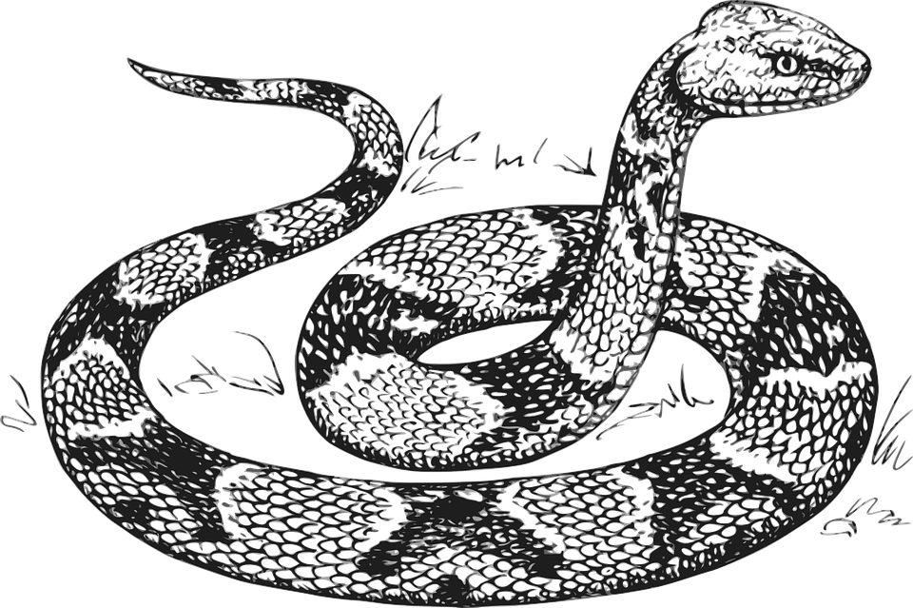
Flora & Fauna
No step on snek!
Academic Services Group

